Slide 1

Estimating the Probability of Confirmed COVID-19 Cases Taking into the Intensive Care Unit
Eda AYDIN | Zilan EROL
Notes:
Onaylanmış COVID-19 vakalarının Yoğun Bakım Ünitesine Alınma İhtimalinin Tahmin Edilmesi

Slide 2
TABLE OF CONTENTS
01
02
03
BUSINESS UNDERSTANDING
DATA UNDERSTANDING
DATA ANALYSIS - VISUALIZATION
04
05
06
DATA MODELLING
MODEL EVALUATION
RESOURCES
This part consists of understanding the problem and finding the data.
This part consists of understanding data.
This part consists of analyzing the data, preparing the data for modelling and visualizations.
This part consists of modelling data by using appropriate models.
This part consists of the inferences and conclusions.
This part consists of the resources we used while doing the project.

Slide 3

01
BUSINESS UNDERSTANDING
Content / Context About the Problem -
Finding the data

Slide 4
COVID-19 Challenges Waiting to Solve
Inadequacy of the health system around the world
“The occupancy of the intensive care unit is increasing”
“The intensive care units are full!”
The Relationship between Time - Patient - Intensive Care Prioritization
Notes:
COVID-19 salgını tüm dünyayı sağlık sisteminin yetersizliği konusunda etkilediğinden sağlık sisteminin düzenini yeniden düşünmemize neden oldu. Artan vakalar nedeniyle her gün duyduğumuz cümlelerden bazıları “Yoğun bakımda doluluk artıyor”, “Yoğun bakım üniteleri doldu.” bu projeye öncü olmuştur.

Slide 5
OUR GOAL
OUR PURPOSE
Determination of the whether the COVID-19 patient needs to be treated in the intensive care unit to preserve the health services system capacity
Giving the most accurate answer to tertiary hospitals based on the available data, based on the patient’s need for ICU support
Providing an accurate answer to local and temporary hospitals based on subsampling of widely available data, based on not needing ICU support
Notes:
Bu cümlelerden yola çıkarak bu projede sağlık hizmetleri sistem kapasitesinin korumak amacıyla COVID-19 hastasının yoğun bakımda tedavi görmesi gerekip gerekmediğinin tespiti yapılacaktır. Burada iki amacımız bulunmaktadır. İlk amacımız, eldeki verilere bakarak, hastanın yoğun bakım desteğine ihtiyaç duyduğuna dayanarak üçüncül hastanelere en doğru cevabı vermeye amaçlamaktadır. Bu şekilde, yoğun bakım kaynakları düzenlenebilir veya hasta transferi planlanabilir. Diğer amacımız ise, yaygın olarak bulunan verilerin alt örneklemine ve yoğun bakım desteğine ihtiyaç duymasına gerek olmadığına dayanarak, yerel ve geçici hastanelere doğru bi cevap sağlamaktır. Böylece ön cephede savaşan hekimler hastaları güvenli bir şekilde taburcu edebilir ve uzaktan takip edebilir.

Slide 6

02
DATA UNDERSTANDING
Collection the data | Understanding the Target

Slide 7
Collection of the Raw Data
Dataset Link: COVID-19 - Clinical Data to assess diagnosis
This dataset consists of :
Patient demographic information
Patient previous grouped diseases
Blood results
Vital signs
Diastolic Blood Pressure
Systolic Blood Pressure
Heart Rate
Respiratory Rate
Temperature
Oxygen Saturation
Notes:
Diastolic Blood Pressure -> Yüksek Tansiyon
Systolic Blood Pressure -> Düşük Tansiyon
Respiratory Rate -> Solunum Hızı

Slide 8
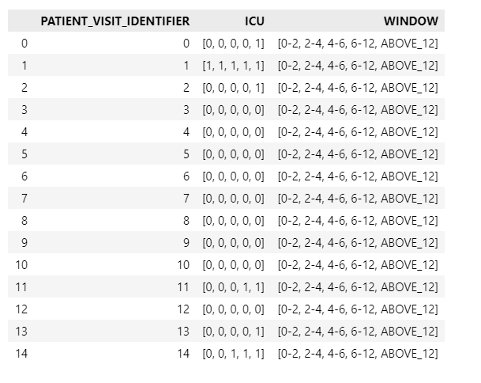
Data Set
Number of rows : 1925
Number of inpatients: 385
Number of features : 230 + 1 (target)
Each patient's medical records in different windows are located on 5 different rows
0 stands for negative → Patient didn’t experienced ICU admission.
1 stands for positive. → Patient experienced ICU admission.
Patient with ID 2 experienced ICU admission after 12 hours
Patient with ID 11 experienced ICU admission between 6 and 12 hours
Patients with ID 12 did not experienced ICU admission.

Slide 9
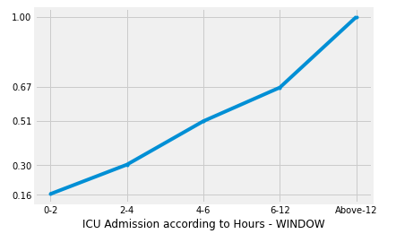
PATIENT - ICU - WINDOW RELATIONSHIP (CUMULATIVE)
Number of patients admitted to ICU between
0 - 2 hours : 32
2 - 4 hours: 27
4 - 6 hours: 40
6 - 12 hours: 31
above 12 hours: 65
Number of patients who experienced ICU: 195
Number of patients who don’t experienced ICU: 190
Number of patients who back to the normal stage: 0

Slide 10
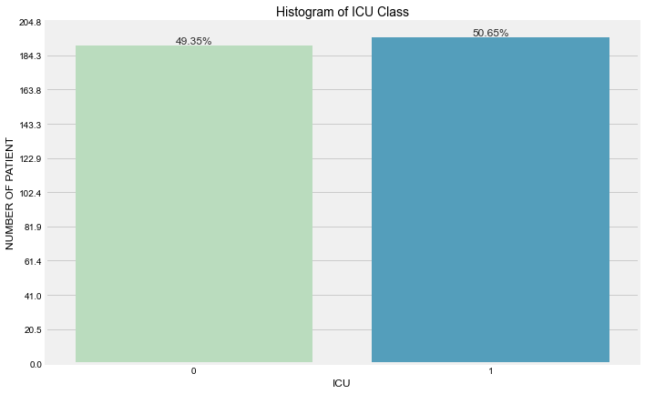
ICU distribution by number of patients

Slide 11
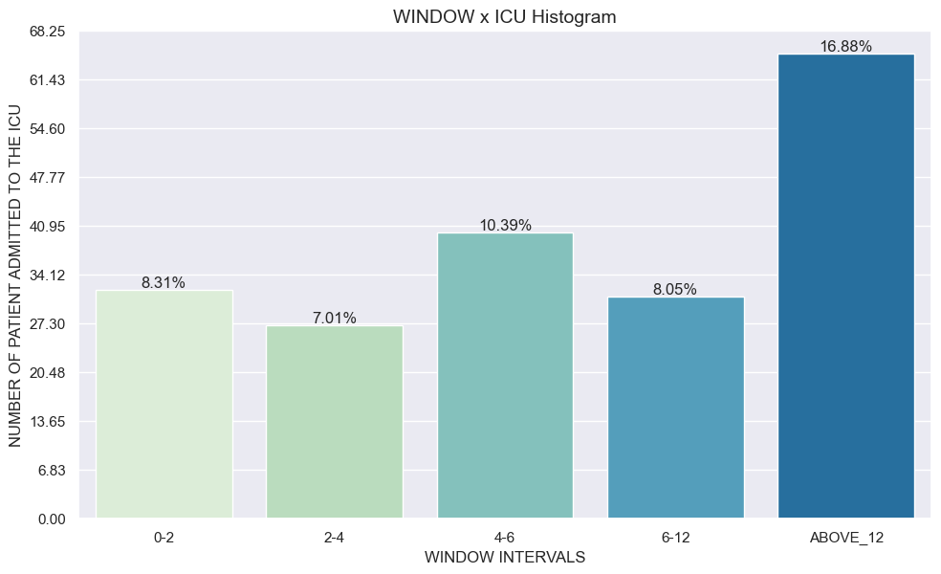
Window, ICU = 1 Distribution by patient number

Slide 12

03
DATA ANALYSIS
Preparatory Data Analysis |
Exploratory Data Analysis

Slide 13
Preparatory Data Analysis
Column / Row Uniqueness
B. Approaches to Missing Data
C. Special Requirements
D. Data Consolidation
Comparison similarities column by column
Change all columns by patient number
Pearson correlation
Imputing with bfill and ffill according to to determined time-series columns patient by patient
Mask data of patients with ICU = 1 in the 0-2 Window Range (This cannot be used in modelling part.)
Redesign the dataset by using another dataset according to patient by patient

Slide 14
Exploratory Data Analysis
Visualizations After Preparatory Data Analysis
With Window Interval, Age Percentile
Visualizations for Specific Features After Preparatory Data Analysis
Patient Constant Features
Time-Variant Features
Remaining Features

Slide 15
Data Visualization After Preparatory Data Analysis

Slide 16
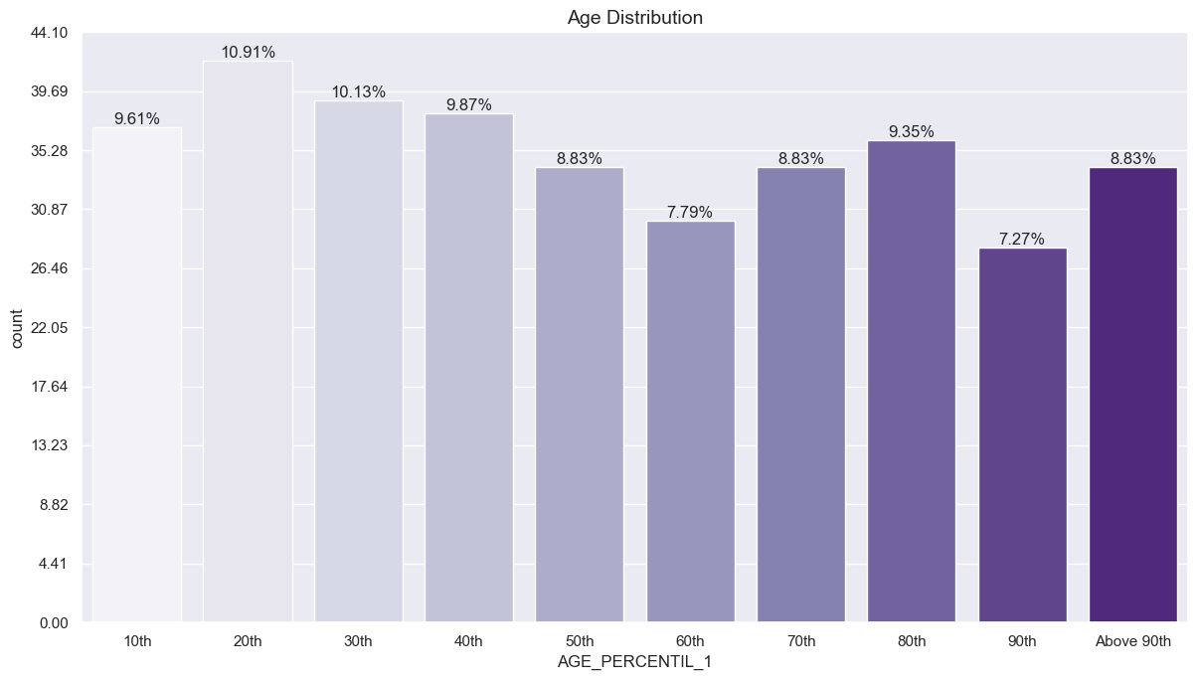
Age distribution by patients

Slide 17
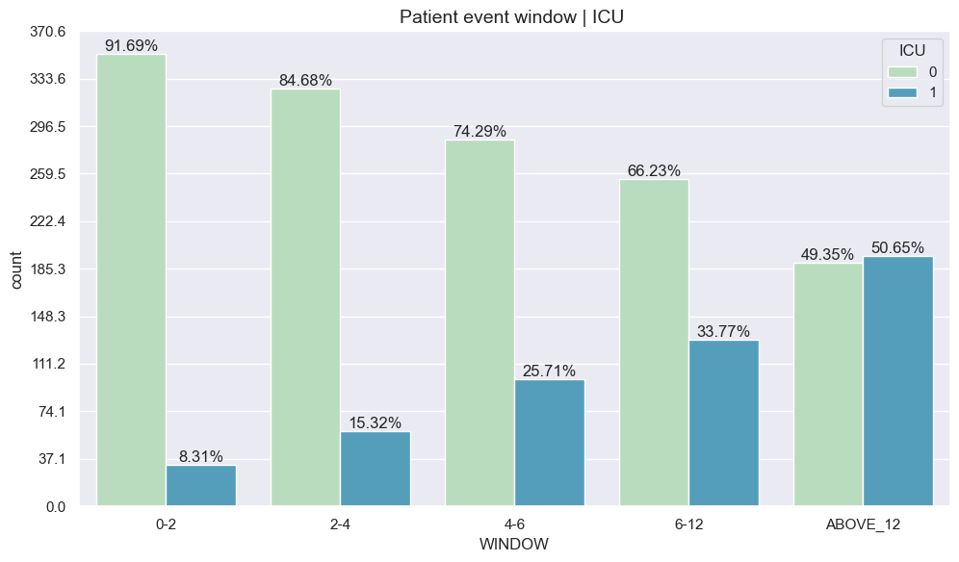
ICU Distribution by Window Intervals

Slide 18
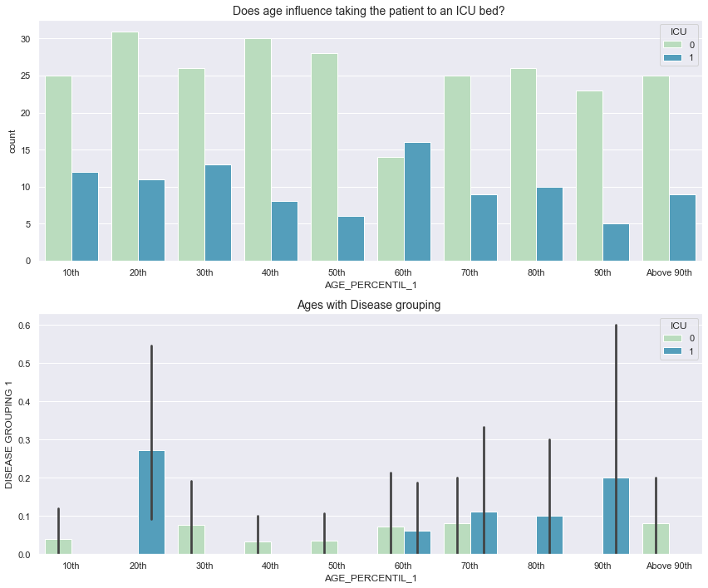
Does age influence taking the patient to an ICU bed?

Slide 19
Does age and disease grouping influence taking the patient to an ICU bed?

Slide 20
Data Visualizations for Specific Features After Preparatory Data Analysis

Slide 21
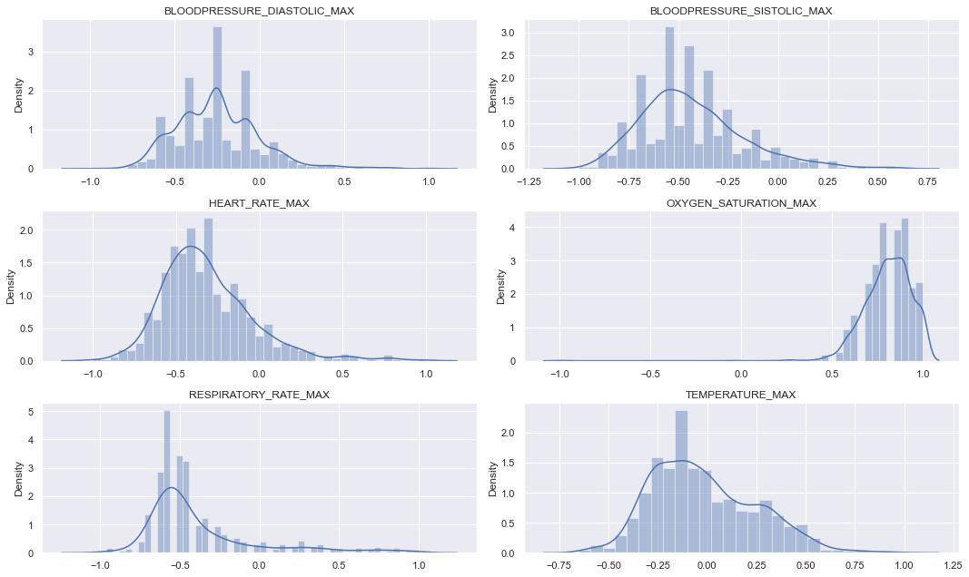
Time variant groups (MAX) distribution by patients

Slide 22
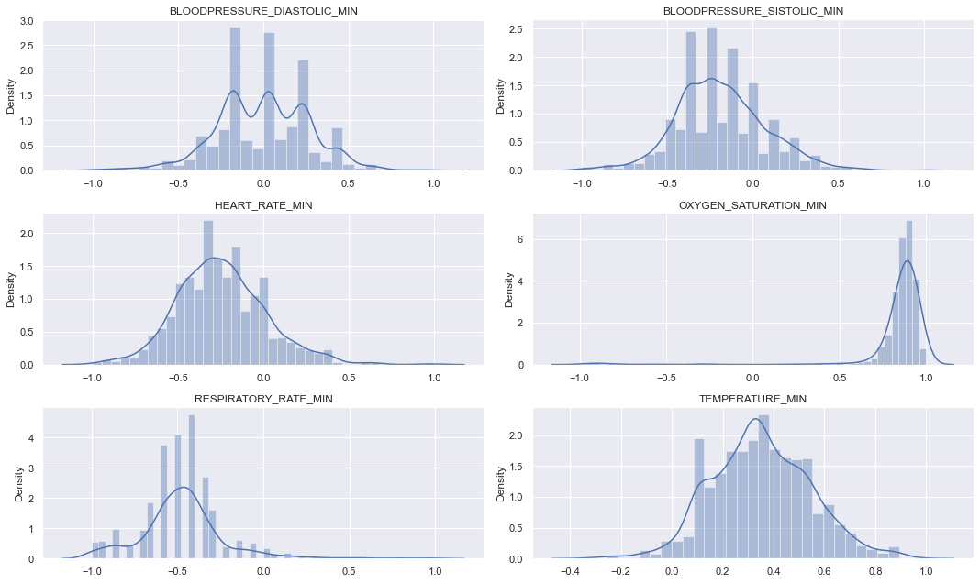
Time variant groups (MIN) distribution by patients

Slide 23

04
DATA MODELLING
WINDOW 1 (0-2 Hours)|
WINDOW 2 - 3 (2-6 Hours) |
WINDOW 4 -5(Above 6 Hours)

Slide 24
Data Modelling Process for Window 1 (0-2 Hours)
Preprocessing Data → Retrieve all data of the patient according to the 0-2 hour interval
Correlations → Identifying importances features that affect ICU value in the 0-2 hour range
Respiratory Rate is the most important feature.
Feature Encoding → Handling categorical features
Data Modelling
KNN → Accuracy: %74
Random Forest Classifier → Accuracy : %78

Slide 25
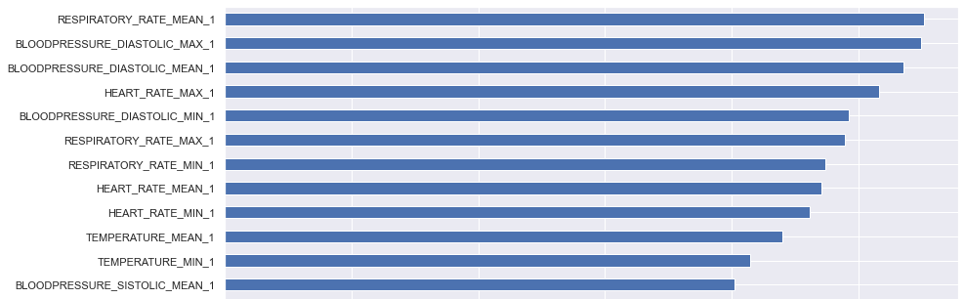
FEATURE IMPORTANCE FOR WINDOW 1 (0-2 HOURS)

Slide 26
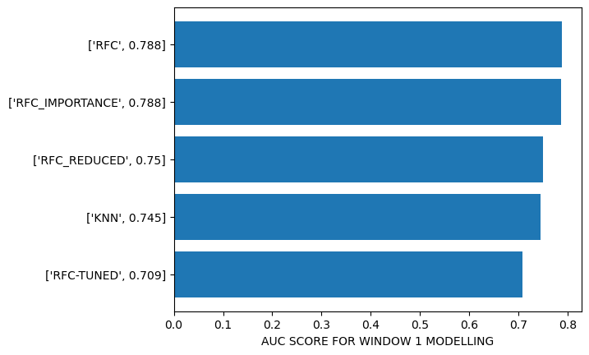
WINDOW 1 (0-2 HOURS)

Slide 27
Data Modelling Process for Window 2 -3 (2 - 6 Hours)
Preprocessing Data → Retrieve all data of the patient according to the 2-6 hour interval | Removing the patients where ICU = 1 in Window 1 to prevent the bias
Correlations → Identifying importances features that affect ICU value in the 2-6 hour range
Respiratory Rate is the most important feature.
Feature Encoding → Handling categorical features
Data Modelling
KNN → Accuracy: %72
Random Forest Classifier → Accuracy : %84

Slide 28
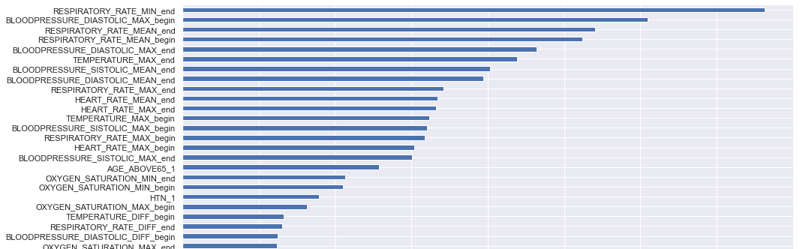
FEATURE IMPORTANCE FOR WINDOW 2-3 (2-6 HOURS)

Slide 29
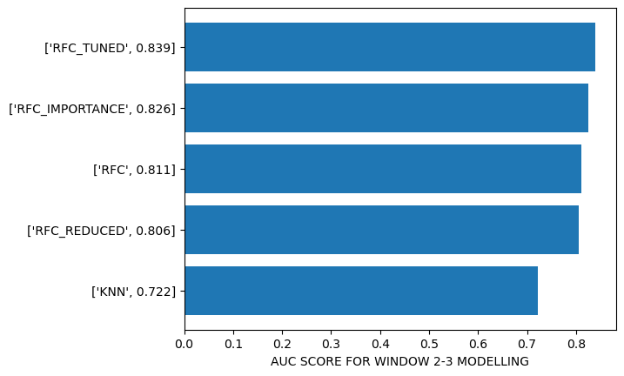
WINDOW 2-3 (2-6 HOURS)

Slide 30
Data Modelling Process for Window 4 - 5 (Above 6 Hour)
Preprocessing Data → Retrieve all data of the patient above 6 hours | Removing the patient where ICU = 1 between 0 - 6 Hours to prevent the bias
Correlations → Identifying importances features that affect ICU value above 6 hours
Respiratory Rate is the most important feature.
Feature Encoding → Handling categorical features
Data Modelling
KNN → Accuracy: %96
Random Forest Classifier → Accuracy : %98

Slide 31
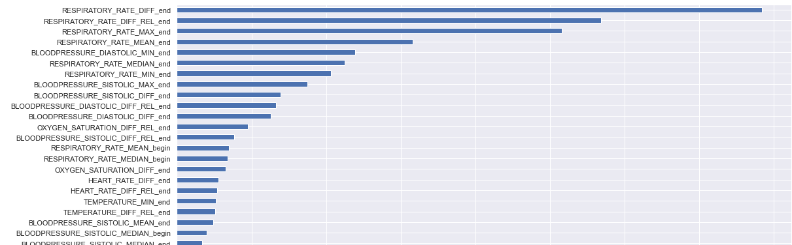
FEATURE IMPORTANCE FOR WINDOW 4-5 (ABOVE 6 HOURS)

Slide 32
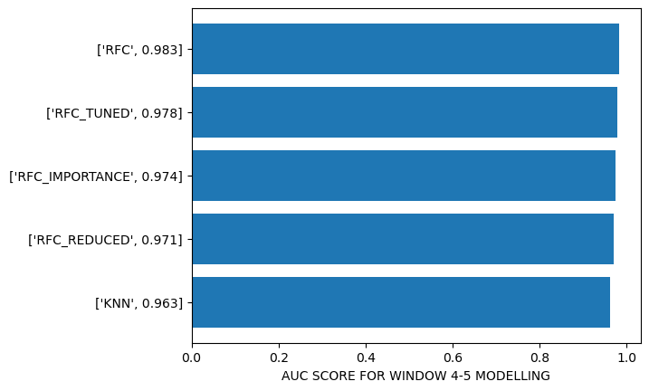
WINDOW 4-5 (ABOVE 6 HOURS)

Slide 33

05
MODEL EVALUATION
COMPARISON AUC SCORES

Slide 34
Model Evaluation
Random Forest gave better results than KNN.
As the number of patients admitted to the intensive care unit increased as time progressed, the accuracy result increased accordingly.
The most important factor in the possibility of being admitted to the intensive care unit is the respiratory rate of the person.

Slide 35
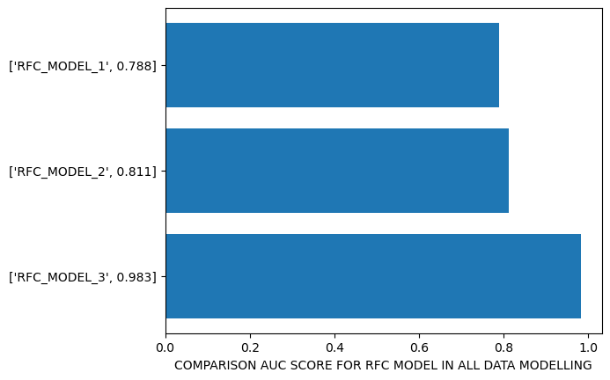
Comparison AUC Score for RFC Model in all Modelling
Notes:
Model 1 için RFC en yüksek geldi.
Model 3 için RFC en yüksek geldi.

Slide 36
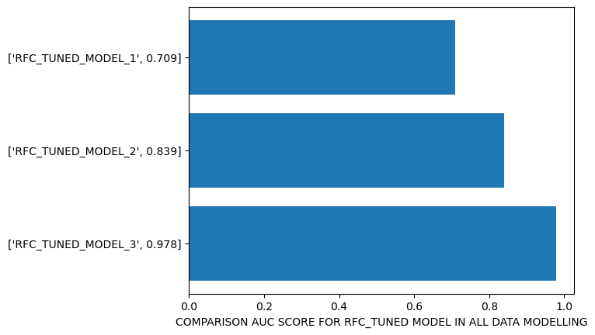
Comparison AUC Score for RFC- Tuned Model in all Modelling
Notes:
Model 2 için RFC Tuned en yüksek geldi.

Slide 37
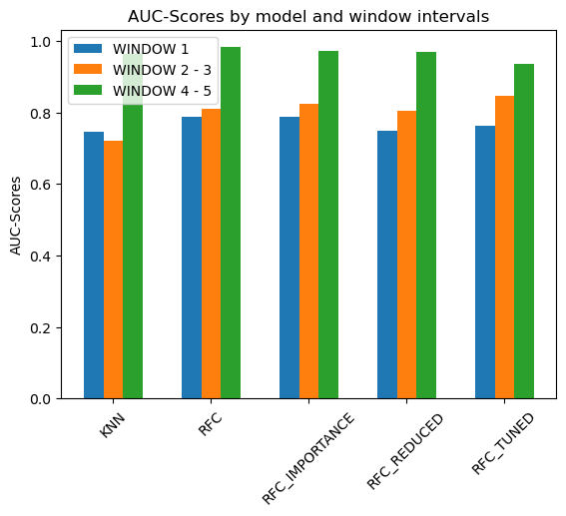
AUC -Scores by model and window intervals

Slide 38
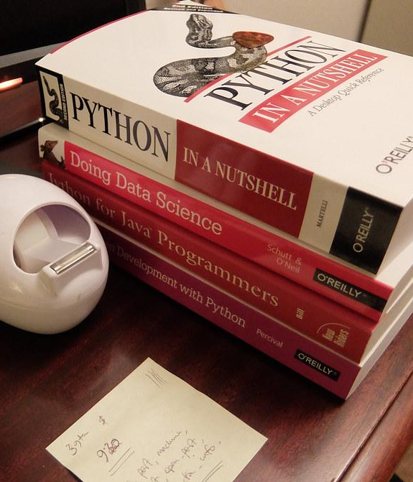
06
RESOURCES
WEBSITES | BOOKS

Slide 39
RESOURCES
WEBSITES
Kaggle
Stackoverflow
Pandas Documentaries
Seaborn Documentaries
GeeksforGeeks
Tutorialspoint.com
MachineLearningMastery.com
BOOKS
Hands-on Machine Learning with Scikit-Learn, Keras & Tensorflow
Introduction to Machine learning
Data Science from Scratch
Python for Data Science Handbook
Practical Statistics for Data Scientists
Python for Data Analysis
Fundamentals of Data Visualization

Slide 40





THANK YOU!
Do you have any questions?

